Slide 1

Chapter 2.1
CLASSES AND OBJECTS
ITP03 | 1ST SEMESTER

Slide 2
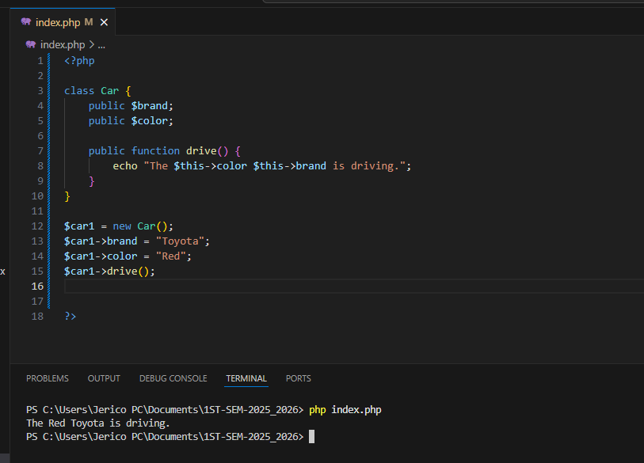
Classes and Objects

Slide 3
Properties and Methods
Properties are variables inside a class that hold data.
Methods are functions inside a class that define behavior.
Access them using the arrow operator (->).

Slide 4
Access Modifiers
MODIFIERS | EXAMPLE | VISIBILITY
public | public $name; | Accessible from anywhere
private | private $age; | Accessible only within the class
protected | protected $salary | Accessible within the class and its subclasses

Slide 5
static
What is static?
-declaring class properties or methods as static makes them accessible without needing an instantiation of the class. These can also be accessed statically within an instantiated class object.
Example syntax
echo MathHelper::sum(10, 20);

Slide 6
$this vs self
$this
Refers to the current object instance of the class.
Can only be used inside non-static methods.
Used when accessing instance (non-static) properties or methods.
Notes:
$myCar = new Car(); // <-- instance of Car

Slide 7
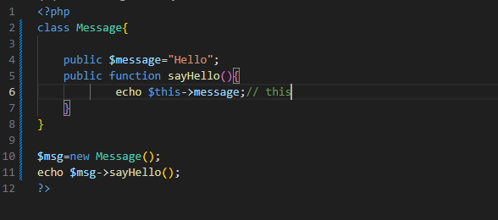
$this

Slide 8
$this vs self
self
Refers to the class itself, not an object.
Used to access static properties/methods within the same class.
Cannot use $this in static methods, so you must use self.

Slide 9
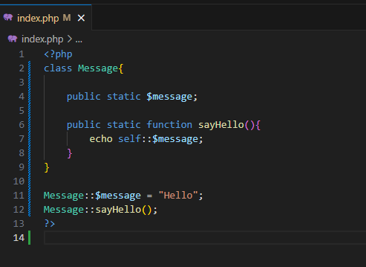
self

